Slide 1
Regression Assumptions

Slide 2
Regression Assumptions
There are several assumed conditions underlying regression analysis.
If the conditions of these assumptions are not met, the regression model will bias coefficients, inflate variance, distort standard errors, and hurt predictions.
It is CRITICAL to assess each assumption and make adjustments / corrections.

Slide 3
OLS Assumptions Overview
Identification Assumptions: Linear in parameters, zero conditional mean, no perfect multicollinearity, correct specification
Efficiency Assumptions: homoscedasticity, no autocorrelation
Inference Assumptions: Normality of residuals

Slide 4
Assumption 1
THIS DOESN’T MEAN WHAT IT SOUNDS LIKE IT MEANS!
LINEAR REGRESSION CAN HANDLE NON-LINEAR RELATIONSHIPS
It basically means that beta values cannot be transformed in any complex way / model must be linear in coefficients, but not necessarily in the variables
Model is linear
(in its parameters)

Slide 5
Linear in Parameters vs Variables
Linear regression does not require that the relationships between X’s and Y we’re estimating be linear.
OLS methods allow us to fit all sorts of non-linear relationships between Y and Xi
We do this by transforming variables and/or using alternative functional forms
The LINEAR part of linear regression is referencing the betas / coefficients, specifically that it is a linear combination of the coefficients
Each coefficient must appear only once, not be multiplied or divided by others, and not be inside a function.
Y = A + (Labor^B1) * Capital^B2) = NO GOOD
Sometimes logarithms solve this issue
ln(Y) = lnA + B1(ln(Labor) + B2(ln(Capital)) = Fine

Slide 6
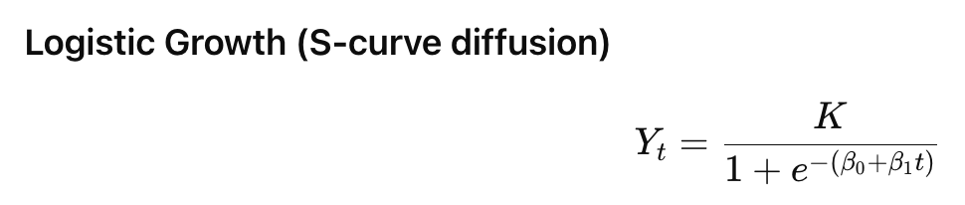
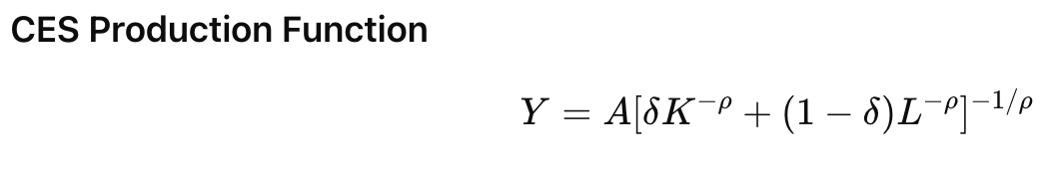
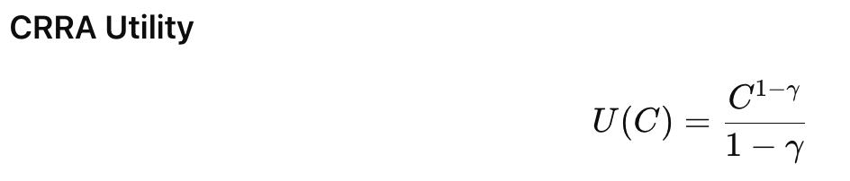
Non Linear In Parameters Models

Slide 7
Assumption 2
No irrelevant variables included
No relevant variables excluded
Functional form is based on logic, theory, & plots
Correct Specification

Slide 8
Independent Variable Selection - Theoretical
Fundamental facts and logic: What variables do we know for sure help determine the value of the dependent variable? Example: Price is obviously critical in determining demand for a vehicles.
Theory: What variables does current academic/professional literature/theory suggest are helpful determining the value of the dependent variable? Do a literature review! Example: Interest rates, the unemployment rate, etc.
Controls: What factors aren’t directly related to facts or theory, but rather additional factors likely to confound your results. Example: Weather conditions impact sales, but indirectly.
Experimental: What we’re testing / trying to prove. Example: Does a new type of advertising / ad campaign impact sales?

Slide 9
Selecting & Operationalizing Variables
Estimating sales at a car dealership
Theorize a general form equation (variables and signs/directions)
Sales = f(inventory +, pricing -, economic conditions *, competitor pricing +, advertising +, weather *, pandemic -, season or month *)
Find specific data and variables to operationalize your theory
Sold Units = f(Inventory at start of month, average difference of MSRP and sale price, local unemployment rate, average discount of MSRP and sale price (scraped from website), $ value of advertising budget, precipitation (rain or snow), month (all but one), and is the time period in question during the Covid pandemic.

Slide 10
Selecting X Variables For Your Model - Technical
How do we select variables?
Signs / Direction: Does the direction of the variable’s effect make sense / match theory? Price increases are unlikely to cause quantity demanded to rise, so a positive relationship is a concern (though it may be fine!)
Bias: How much do other variables change in magnitude and direction when other variables are added / removed?
T-testing / p-value: Does the variable have any statistical significance? Variables are statistically significant if their p-value is below your selected alpha.
Adjusted R^2: Does a variable’s inclusion raise or (lower adjusted) R^2? Higher = Better
AIC / BIC: Does a variable’s inclusion raise or lower AIC / BIC? Lower = Better

Slide 11
The Role of Theory
Theory should guide your choice of variables!
Even if statistically insignificant be very reluctant to omit a variable that is:
Conceptually fundamental
Well established in the professional/academic literature
Even if statistically significant, never include a variable that makes no logical sense!

Slide 12
Consequences & Solutions of Omitted Variables
Detection
1) Logic / theory
2) Unexpected signs
3) Poor model fit
4) Changes in coefficients when controls are added
Consequences
1) Bias in coefficients (magnitude and/or direction)
2) Hypothesis testing is unreliable
3) Confidence intervals are unreliable
4) Low predictive power / inaccurate predictions
Solutions
1) Include the omitted variable in the regression - Duh!
2) Include a proxy variable if the actual variable cannot be included

Slide 13
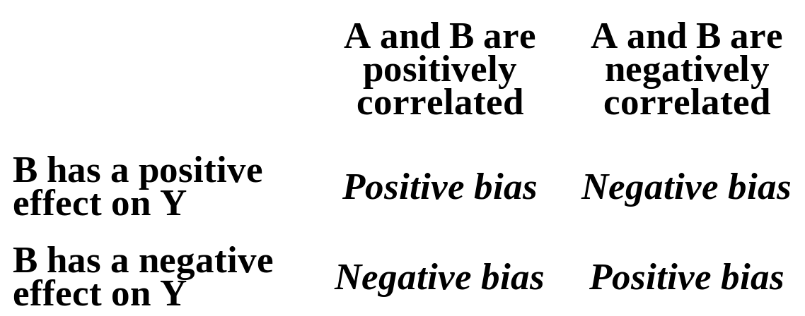
How Omitted Variables Bias Coefficients
True Model: Y = B0 + B1(X) + B2(Z) + E
Estimated Model: Y = B0 + B1(X) + E
Z is omitted
If Z is correlated with Y and X
Bias(B1) = B2 * (Cov(X,Z) / Var(X))
If B2 and Cov(X,Z) are both positive or negative, Bias is Positive
If is positive and the other is negative, Bias is Negative

Slide 14
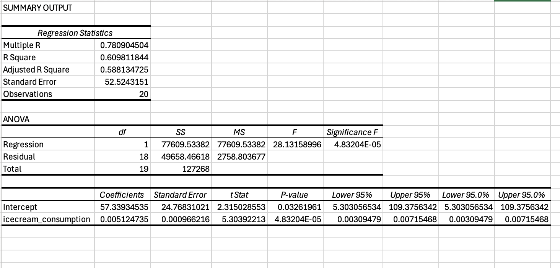

Slide 15
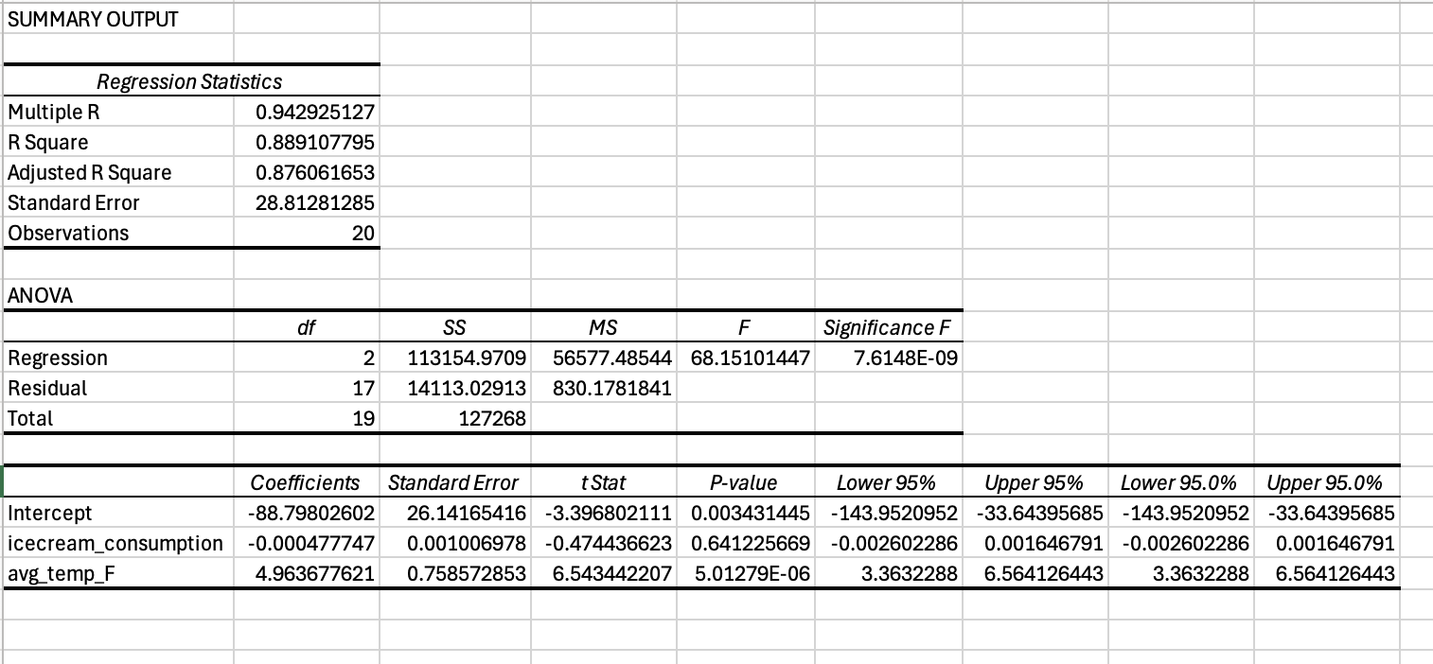

Slide 16
Specification Error - Omitted X Variable
Domestic GDP = (Consumption) + Investment + Government Spending
Variable | Coefficients | Standard Error | t Stat | P-value
Intercept | 221.767402 | 10.5921799 | 20.9368991 | 1.7731E-57
Investment | 0.50870401 | 0.04586227 | 11.0919945 | 1.2808E-23
Government | 0.09740345 | 0.01837915 | 5.2996704 | 2.4975E-07
Consumption | 1.27937902 | 0.01764116 | 72.5223846 | 3.797E-173
Variable | Coefficients | Standard Error | t Stat | P-value
Intercept | 176.605521 | 48.8939703 | 3.61201023 | 0.00036508
Investment | 3.34495811 (Higher) | 0.11077061 (Higher) | 30.1971636 (Higher) | 1.1444E-86 (Lower)
Government | 1.12138656 (Higher) | 0.0544051 (Higher) | 20.6117923 (Higher) | 1.858E-56 (Lower)

Slide 17
Consequences & Solutions of Irrelevant Variables
Detection
1) Logic / theory
2) T-test / P-value
3) Adjusted R^2
4) Impact on other coefficients
Consequences
1) Larger standard errors
2) Wider confidence intervals
3) Lower precision / efficiency
4) Possible overfitting
Solutions
Remove irrelevant variable(s) - Duh!

Slide 18
Specification Error - Included Irrelevant X Variable
Variable | Coefficients | Standard Error | t Stat | P-value
Intercept | 221.767402 | 10.5921799 | 20.9368991 | 1.7731E-57
Investment | 0.50870401 | 0.04586227 | 11.0919945 | 1.2808E-23
Government | 0.09740345 | 0.01837915 | 5.2996704 | 2.4975E-07
Consumption | 1.27937902 | 0.01764116 | 72.5223846 | 3.797E-173
Domestic GDP =
Consumption +
Investment
+
Government
Variable | Coefficients | Standard Error | t Stat | P-value
Intercept | 218.245023 | 15.811014 | 13.803354 | 8.987E-33
Investment | 0.50963482 (Higher) | 0.04604795 (Higher) | 11.0674814 (Lower) | 1.5951E-23 (Higher)
Government | 0.09762164 (Higher) | 0.01842608 (Higher) | 5.298015 (Lower) | 2.5251E-07 (Higher)
Consumption | 1.27901116 (Lower) | 0.01771481 (Higher) | 72.2000999 (Lower) | 3.249E-172 (Higher)
Random | 7.34242104 | 24.4336968 | 0.30050389 | 0.76403672

Slide 19
Parsimony and Occam's Razor
Less is better, all things being equal
An equally effective model with less complexity is likely superior for practical, scientific, and philosophical reasons
Overfitting: Creating a model so specific that it is perfect for describing the dataset used to train the model, but has much less value when tested “out of sample”
Less specificity means less chance of overfitting

Slide 20
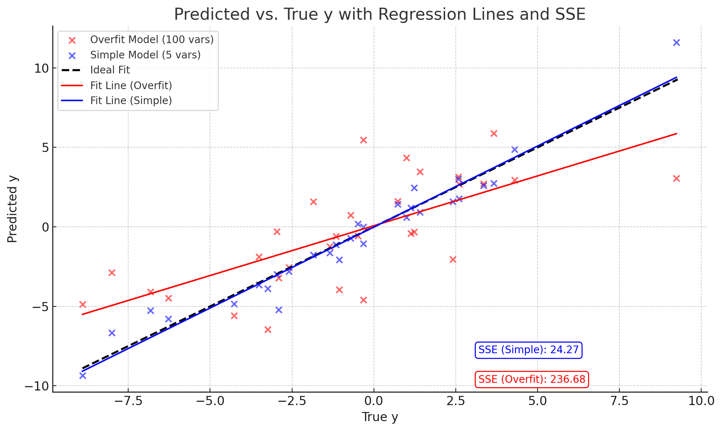

Slide 21
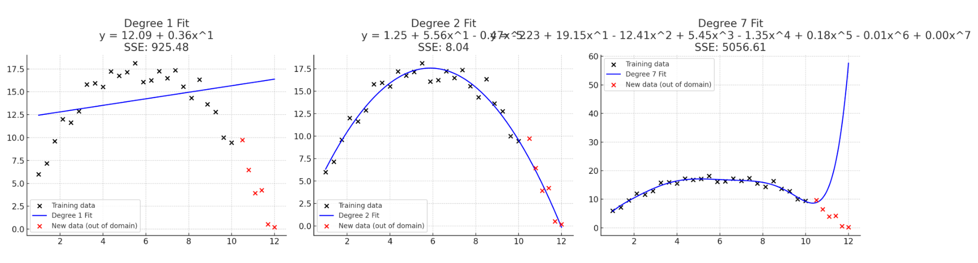
Overfitting - Future data

Slide 22
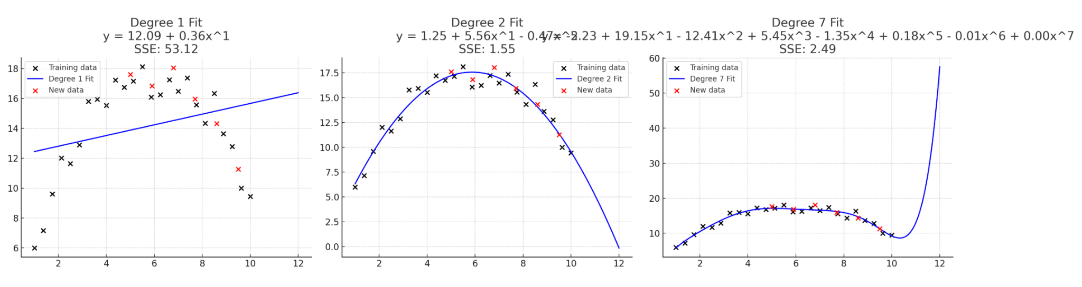
Overfitting - Data left out

Slide 23
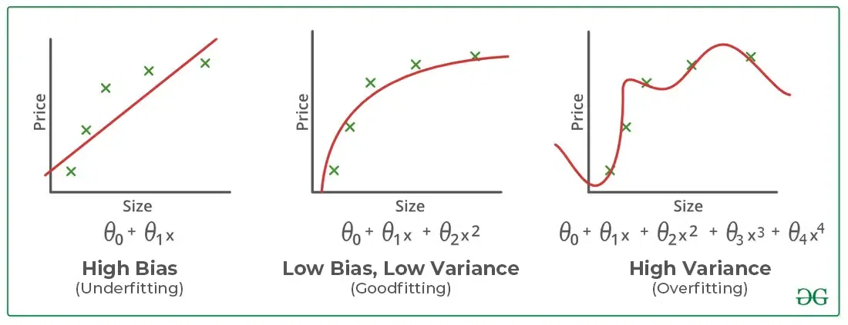
Stepwise Selection - Not Usually A Good Idea
It’s possible to have a computer select your variables for you, but you probably shouldn’t do it.
Results may fail to generalize / model may be “overfitted”
May give unstable models and misleading p-values
Stepwise forward: Start with minimum number of variables needed and build up the model from there, adding more variables than you subtract
Stepwise backward: Start with the maximum number of (reasonable, logical, theoretical) variables and trim down the model from there, subtracting more variables than you add
Stepwise mixed: Both of the above
Comparison criteria: R^2 (+), Adjusted R^2 (+), AIC (-), BIC(-), T-Stats (+) / P-Values (-) of variables, signs of variables, F-Stat / P-Value of full model

Slide 24
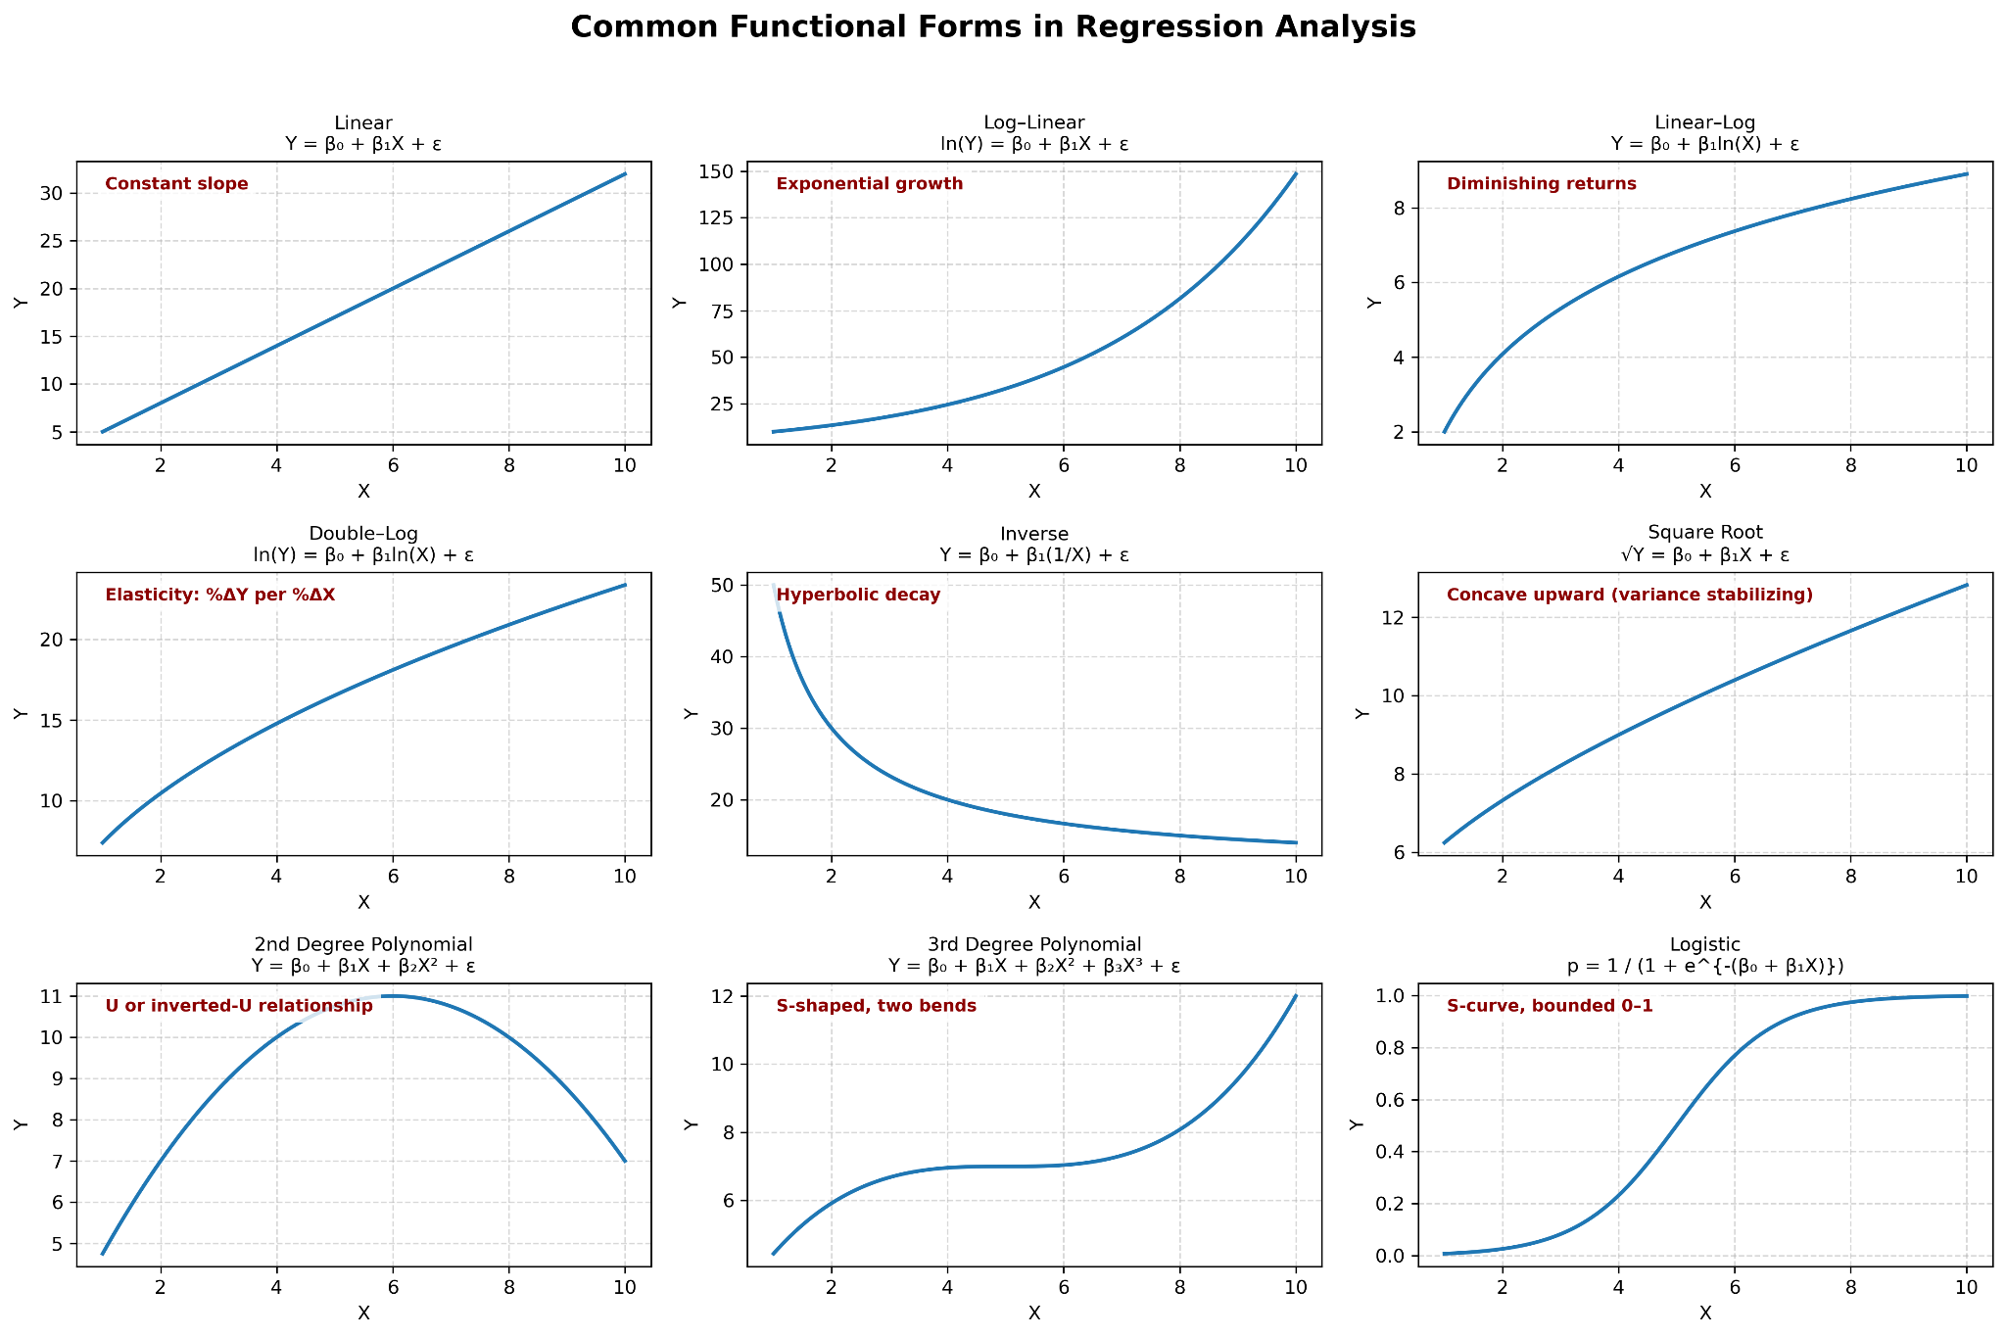
FUNctional Form
Linear: Y = B0 + B1x + e
Log-linear: ln(Y) = B0 + B1*x + e
Linear-log: Y = B0 + B1*ln(x) + e
Double-log: ln(Y) = B0 +B1*ln(x) + e
Polynomial (2nd): Y = B0 + B1*x + B2*x^2 + e
Polynomial (Nth): Y = B0 + B1*x + B2*x^2…Bn*x^n + e
Inverse: Y = B0 + B1*(1/x) + e
Square Root: Sqrt(Y) = B0 + B1*x1 + e
Interaction: Y = B0 + B1*x1 + B2*x2 + B3*(x1*x2) + e
Logistic* (NOT OLS)

Slide 26
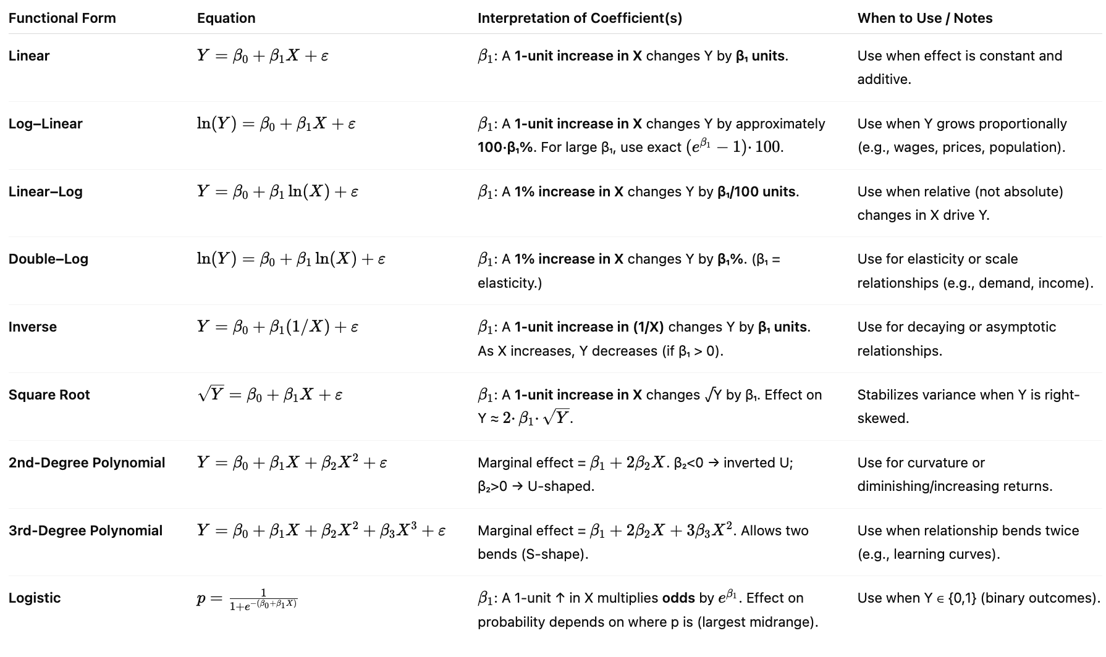
Coefficient Interpretation

Slide 27
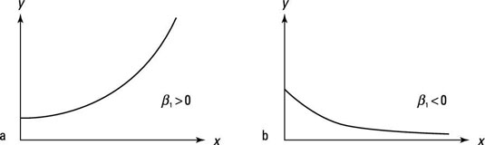
Log-Linear Model
Used to change non-linear equations into linear equations
Take the natural logarithm of the dependent variable
ln(Y) = B0 + B1*X1 + E
Coefficient interpretation: For small coefficients, a one-unit increase in X is associated with an approximate 100 x B% change in Y.
For larger coefficients, use 100((e^B) -1)%

Slide 28
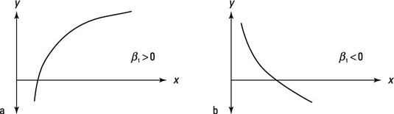
Linear-Log Model
Used to change non-linear equations into linear equations
Take the natural logarithm of the independent variables
Y = B0 + B1*ln(X1) + E
Coefficient interpretation: A one percent change in X leads to a B/100 unit change in Y

Slide 29
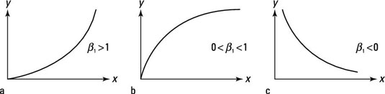
Log-Log
Used to change non-linear equations into linear equations
ln(Y) = B0 + B1*ln(X) + E
Take the natural logarithm of the dependent variable and independent variables
Coefficient interpretation: A one % change in X leads to a B percent change in Y = Elasticity

Slide 30
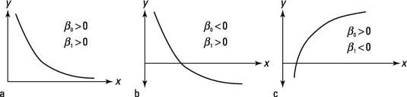
Inverse
Y = B0 + B1(1/X) + E
A one unit increase in x leads to a non-linear change in Y by B1. B1 > 0, y is decreasing as x increase

Slide 31
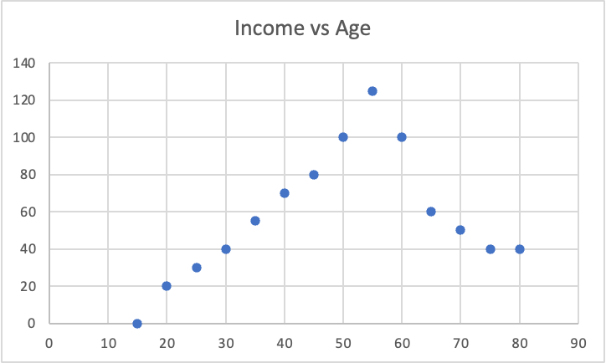
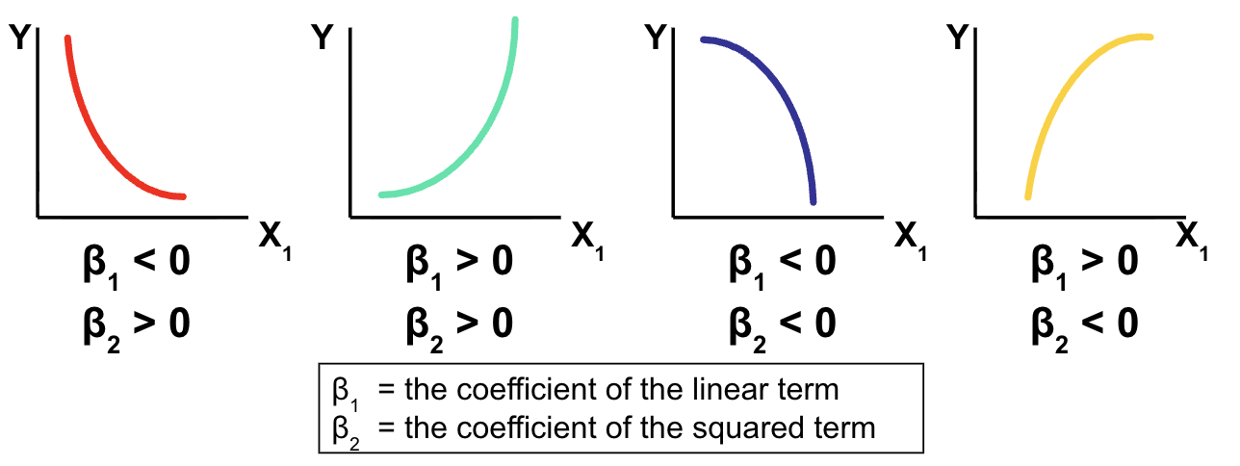
Polynomial / Quadratic Form
If a relationship between X and Y is concave or convex, a quadratic form may be needed
Y = B0 + B1(X1) + B2(X1^2) + E
Example: Income = f(Age)
As age rises (16-60) earned income rises too, but at a certain point, people retire and their earned income falls (60-100…)
A properly formed model would include an age^2 variable
Income = f(Age + Age^2)
Can be more than quadratic polynomial, depending on inflection points (X^2 = 1 inflection point, X^3 = 2 inflection points)
Interpretation is complex but can still be used for prediction
Notes:
Turning point vs inflection point

Slide 32
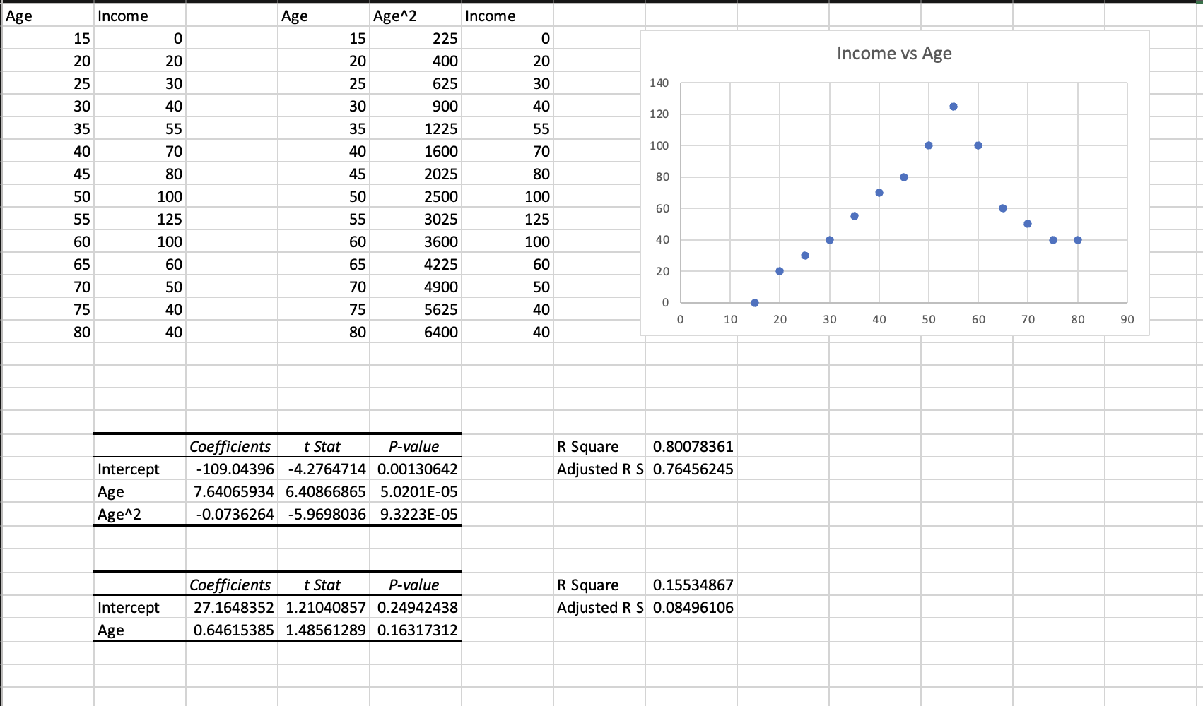
Polynomial / Quadratic Form

Slide 33
Consequences & Solutions of Incorrect Functional Form
Detection
1) Logic / Theory
2) Plots of x vs y
3) Residual analysis*
4) Ramsey's RESET Test
Consequences
1) Biased coefficients
2) Hypothesis testing is unreliable
3) Confidence intervals are unreliable
4) Inaccurate predictions
Solutions
1) Try different functional forms
2) Transform variables (log, sqrt, inverse)

Slide 34
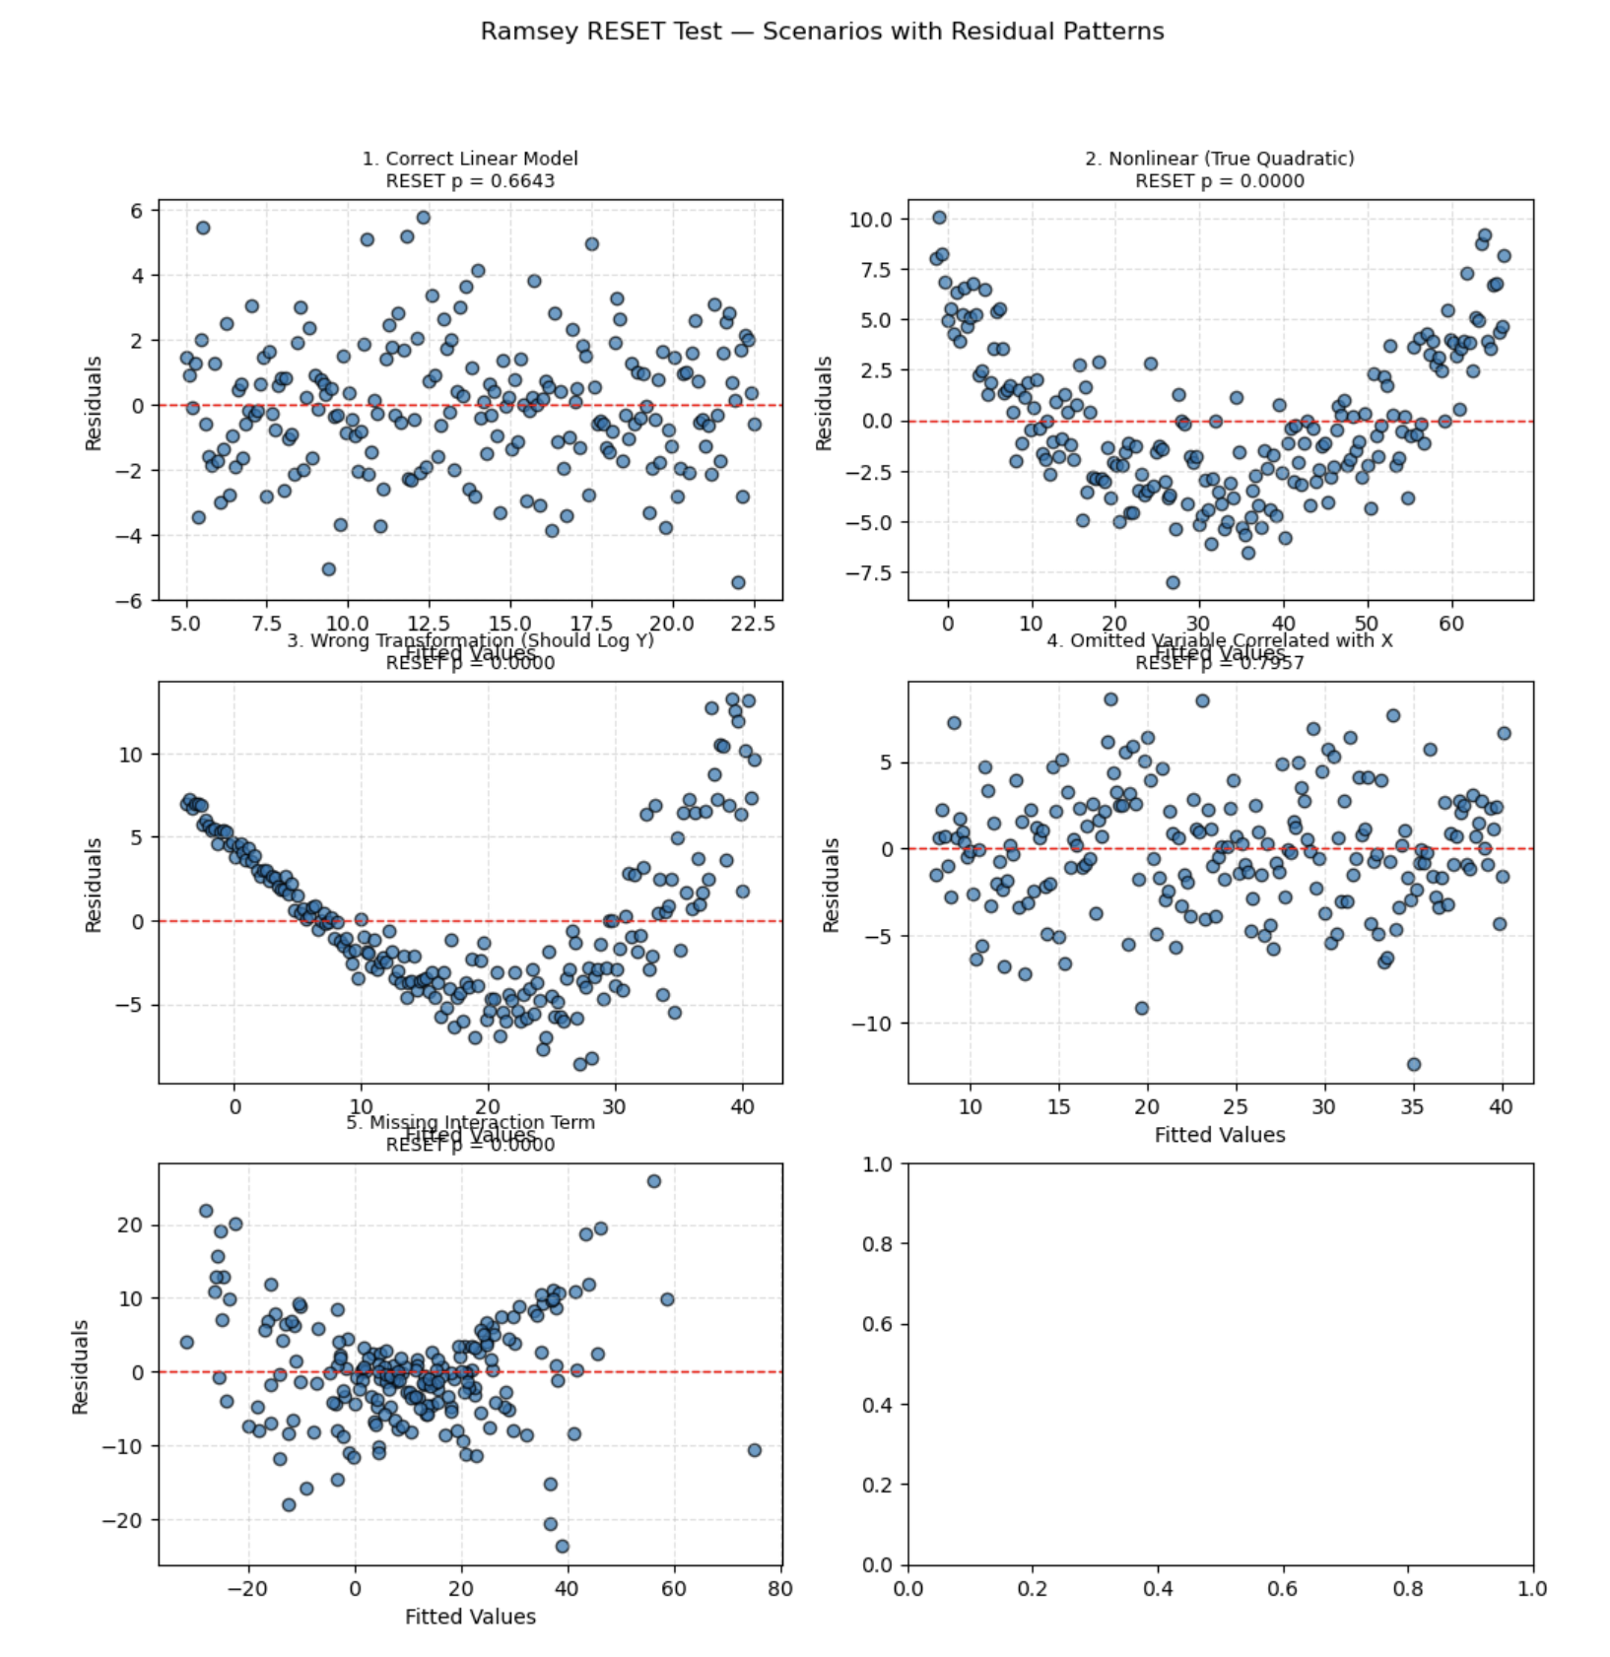
Ramsey’s RESET Test
Can test for
Incorrect functional form
Incorrect transformations
Non linearities
Omitted variables that are correlated with included variables
Missing interactions
Provides hint of problem, but not many insights for solution
Step 1: Estimate a regression model
Step 2: Estimate another regression model using the Y-hat^2 and Y-hat^3 as additional independent variables
Step 3: Test the new variables for statistical significance. If they are significant, this points to the need for squared or cubic variables, or an alternate functional form

Slide 36
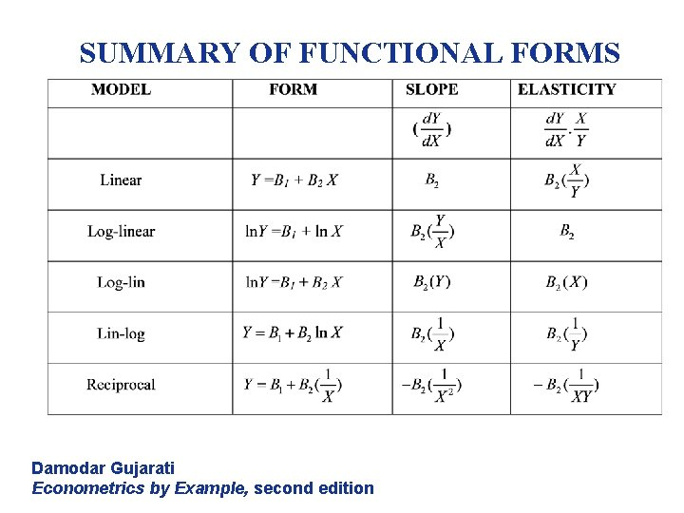

Slide 37
Assumption 3
E(e | X) = 0
The error term is unrelated to the independent variables
All systematic relationships between Y and X are captured in the model
Zero Conditional Mean of Errors

Slide 38
Zero Conditional Mean of Errors
Detection:
Theory / domain knowledge
Coefficient instability
Residual patterns
RESET Test
Endogeneity clues (reverse causality, simultaneous relationships, selection effects.
There are no statistical tests for this.
Consequences:
Biased coefficients
Inconsistent estimates
Wrong causal interpretation
Hypothesis testing becomes misleading
Solution:
Add missing variables
Use proxy variables
Fixed effects (control for unobserved, time-invariant factors)
Causal methods

Slide 39
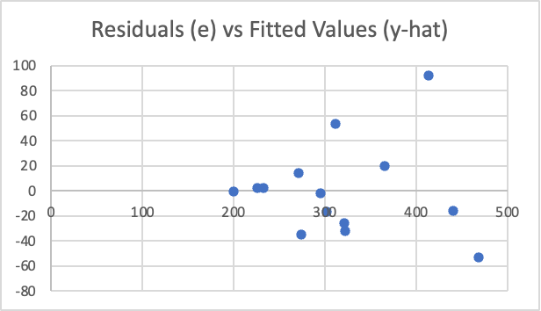
Assumption 4
Homoscedasticity
(Variance of errors is constant)

Slide 40
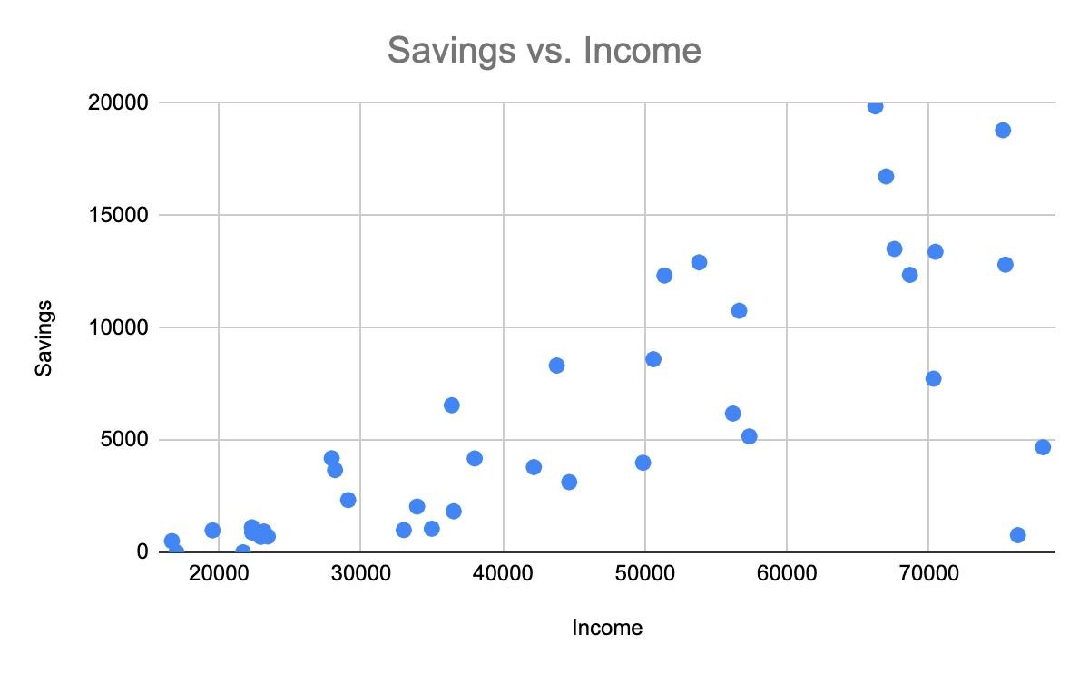
Heteroskedasticity in Savings Rates
In economics, we study consumption as a percentage of income, as a function of income.
The marginal propensity to consume is the percentage of income consumed vs saved.
Higher income households have more opportunities to save, but don’t necessarily save more than lower income households

Slide 41
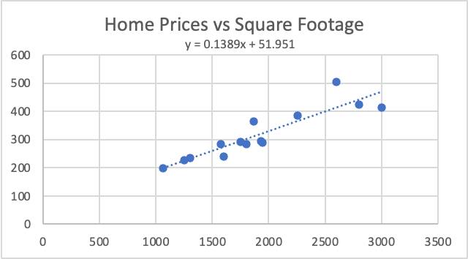
Heteroskedasticity

Slide 42
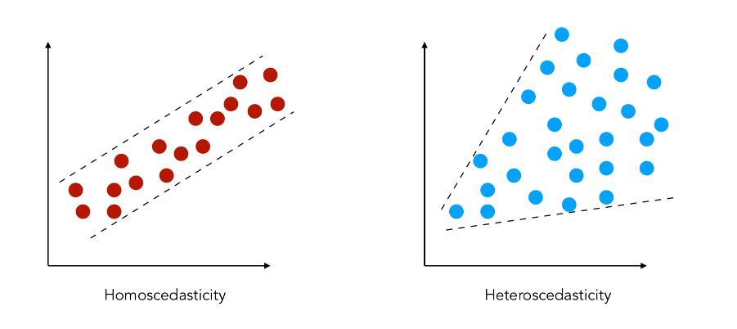
Assumptions: Homoscedasticity

Slide 43
Consequences & Solutions of Heteroskedasticity
Detection
1) Plot residuals against fitted values and each x variable looking for spreading pattern
2) White test:
H0: Homoscedasticity
HA: Heteroskedasticity
Consequences
1)OLS regression is no longer minimum variance
2) Hypothesis testing is unreliable
3) Confidence intervals are unreliable
Solutions
1) Transform variables
2) Change functional form
3) Use WLS or GLS
4) Use heteroskedasticity-robust standard errors

Slide 44
Assumption 5
Observations are independent of each other
No observation provides information about another
Cov(ei,ej) = 0 for i =/= j
No clustering, spillovers, or time-dependence
Random Sampling / Independence

Slide 45
Types of Dependence
Time dependence = Autocorrelation
Cluster dependence = Groups share shocks
Spatial dependence = Nearby units influence each other
Panel dependence = Repeated observations per unit

Slide 46
Random Sampling / Independence
Detection:
Data structructures (repeated observations per unit, geographic grouping, etc.) = Main CLUE
Residual patterns over time (cluster or trend)
Autocorrelation plots (ACF)
Durbin Watson test
Group level clustering
Consequences:
Standard errors are biased
False statistical significance of some variables
Confidence intervals are invalid (too narrow)
Hypothesis testing is unreliable
Solution:
Clustered standard errors (for within groups)
Time series models
Lagged variables
Fixed effects (panel data)
GLS
Newey-West standard errors

Slide 47
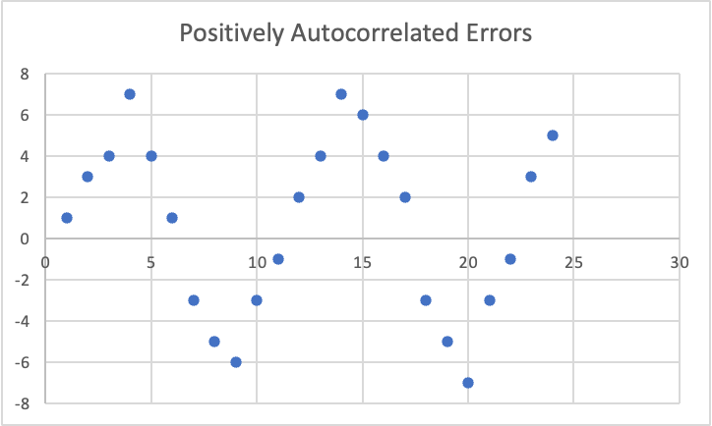
Assumption 6
Non-Autocorrelated Residuals
(Errors are not correlated with each other)

Slide 48
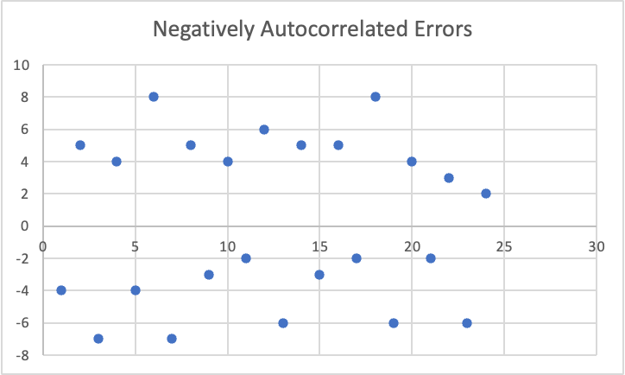

Slide 49
Consequences & Solutions of Autocorrelation
Detection
1) Plot residuals vs time and look for patterns
2) Durbin-Watson test*:
<1.5 = Positive Autocorrelation
2 = No autocorrelation
>2.5 = Negative Autocorrelation
Consequences
1)OLS regression is no longer minimum variance
2) Hypothesis testing is unreliable
3) Confidence intervals are unreliable
Solutions
1) Find and add an omitted variable
2) Change functional form
3) Use GLS or Newey-West standard errors
Typically autocorrelation is a time-series or spatial problem

Slide 50
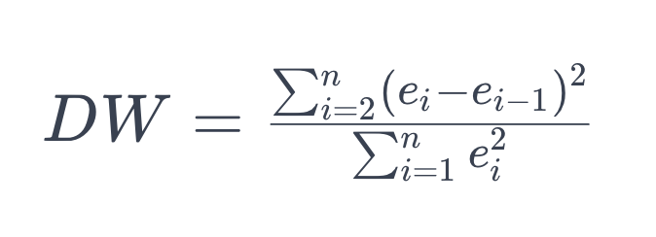
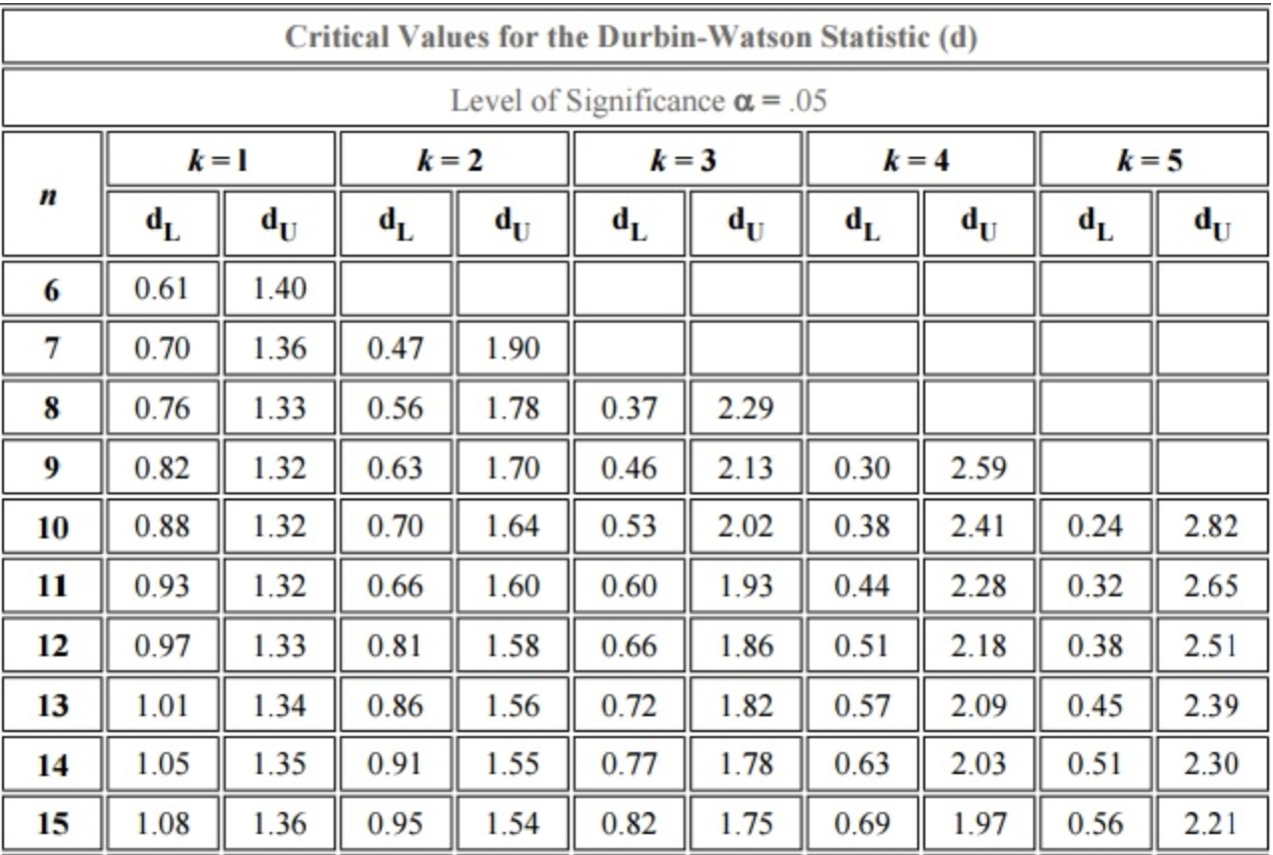
Durbin-Watson Test
1.5 < DW < 2.5 is a rule of thumb. More formally…
1) Calculate DW statistic for given regression model.
2) Lookup specific cutoffs from a Durbin-Watson statistical table / software.
Find critical values based on
1) Alpha
2) Sample size
3) Number of independent variables
DW-stat < dL = Positive autocorrelation
DW-stat > dU = Negative autocorrelation
DW-stat = 2 = No Autocorrelation

Slide 51
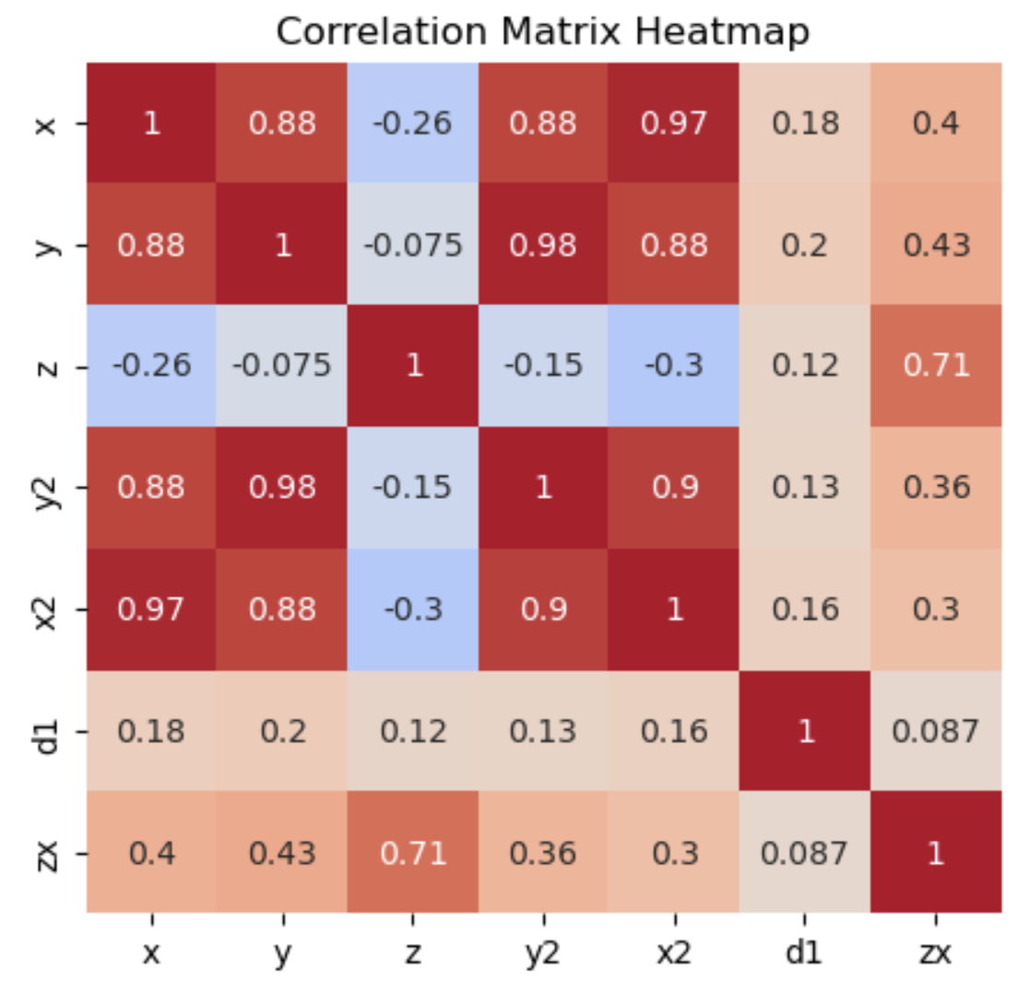
Assumption 7
No (Perfect) Multicollinearity
Independent variables are not (perfectly) correlated with each other

Slide 52
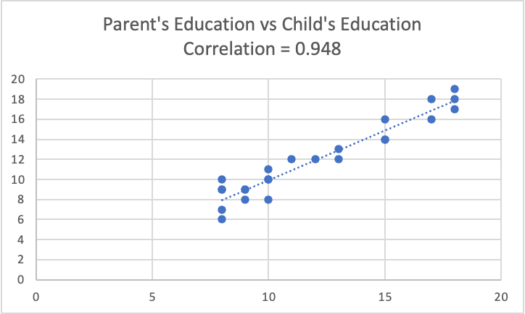

Slide 53
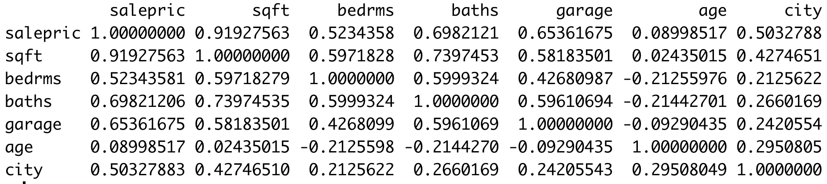
Finding Multicollinearity
Correlation Matrix
Run separate regressions with each independent variable used as the dependent variable vs all the other independent variables
VIF(X) = 1 / (1 - R^2) for each variable
VIF = 1 = No problem!
1 <= VIF <= 5 = Mild problem
6 <= VIF <= 10 = Moderate problem
VIF > 10 = Large problem
Variance Inflation Factor

Slide 54
Assumptions: No (Perfect) Multicollinearity
Detection:
Variance inflation factor test, >5 = problem, > 10 equals large problem
Correlation matrix or plot of independent variables against one another (.8) or more is likely too much
Consequences of multicollinearity:
Hypothesis testing is unreliable
Confidence intervals are unreliable
With perfect multicollinearity, OLS doesn’t work at all.
Solutions:
Remove one or more of the affected variables from the model
Combine affected variables into a single variable (PCA, indices, etc.)
Ridge regression
Do nothing!?

Slide 55
Assumption 8*
Not really a standard OLS assumption, but important!
n > 10*k
Enough (Complete) Data

Slide 56
Sample Size, Variables, and Degrees of Freedom
Degrees of Freedom (for regression) = n - k - 1
n = observations, k = variables, 1 = for the constant / intercept
So with 40 rows and 5 variables, you have 34 DoF
Must have at least as many observations as variables for OLS to compute, but many more observations needed for sound estimates and inference
Rule of thumb = 10 observations per independent variable
Less than 20 DoF = PROBABLY NO GOOD

Slide 57
More Data = Better!
More data gets you:
Lower variance in estimates
Fewer Type 2 Errors (Effect exists but isn’t detected)
TIghter confidence intervals
Better generalization (less overfitting)
Better ability to handle complexity (interaction terms, non-linear terms, etc)
Smaller and/or more stable p-values

Slide 58
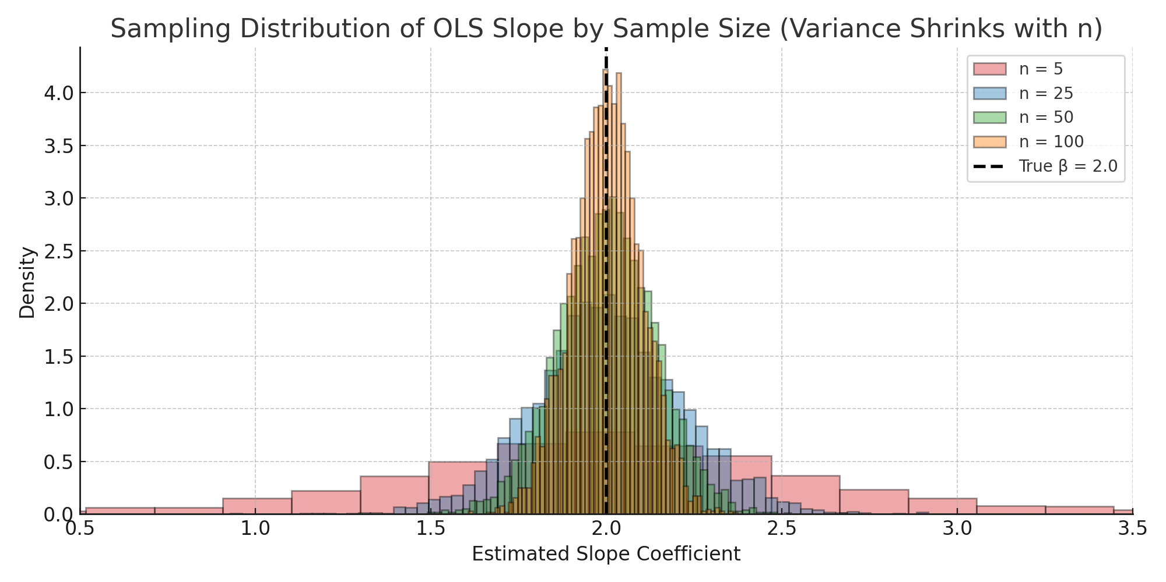

Slide 59
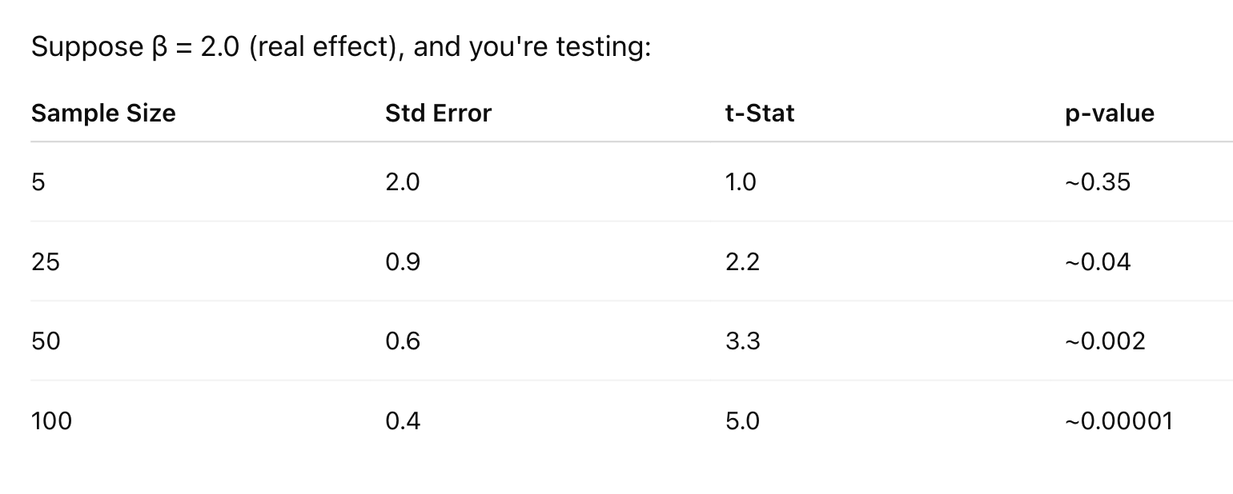
If not significant, more data drives p-values toward 1

Slide 60
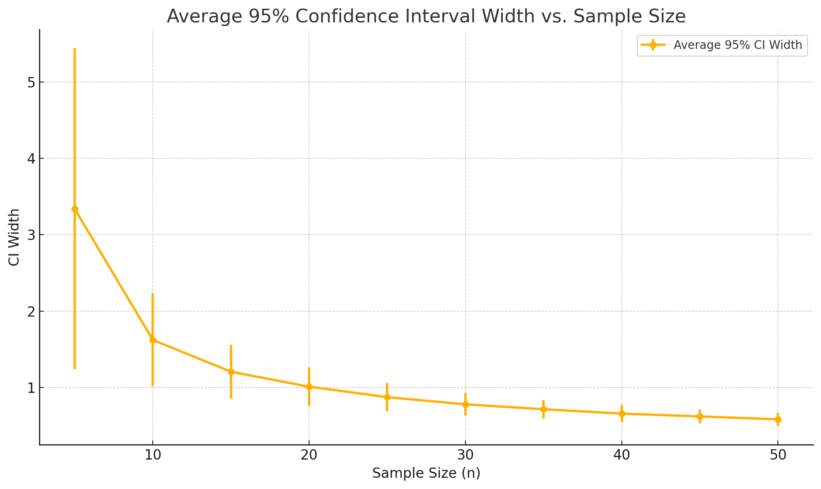

Slide 61
Is More Data Ever Bad?
More data could be bad if
Trends have changed (customer behavior from a decade ago might not resemble current behavior)
Data is unbalanced*
Computation costs and/or time needed to compute are high
Collection is costly or difficult
Notes:
Fraud cases = 0.1% of all transactions You collect millions of new transactions — but if 0.1% are still fraud, you've only gained a handful of extra positives. Unless you balance or weight the model properly, it'll just learn to predict "not fraud" better and better — which is catastrophic in practice.

Slide 62
Diagnostics Plots
Proper regression analysis requires lots of diagnostic graphics!
Plot all X variables against Y: This helps us understand the relationship between variables and suggests the possible need for alternative functional forms and variable transformations
Plot Y-Hat against Y: This helps us see how accurate our model’s predictions are
Plot residuals against Y-Hat: This helps us assess many of our regression assumptions and detect outliers
Plot residuals against all X variables: This also helps us assess many of our regression assumptions
Plot residuals against time (if time-series): This helps us detect autocorrelation
Normal Q-Q Plot and/or Histogram of Residuals: This helps us see if residuals are centered on zero and normally distributed

Slide 63
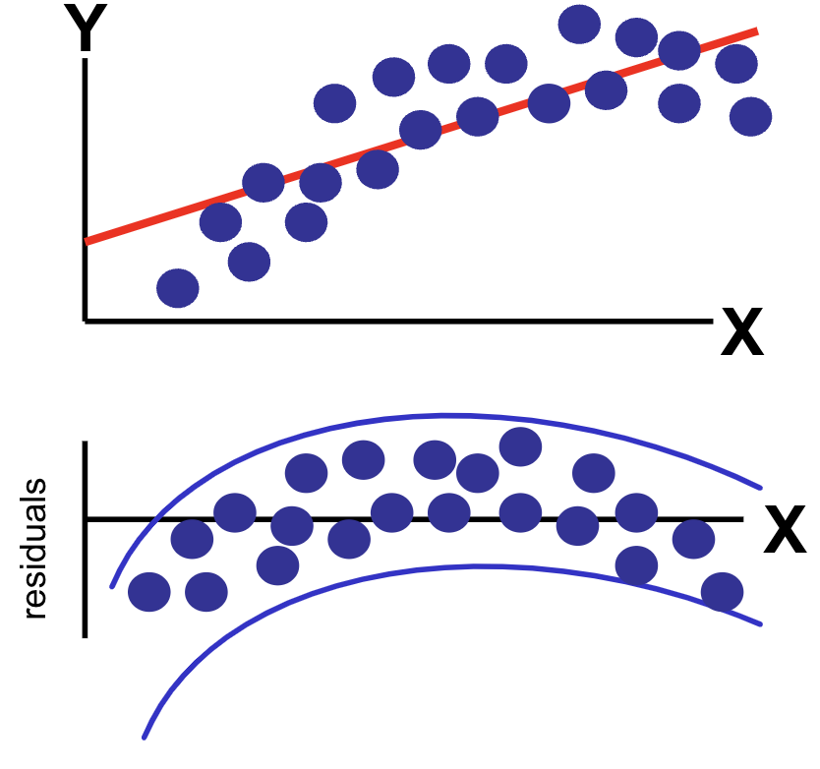
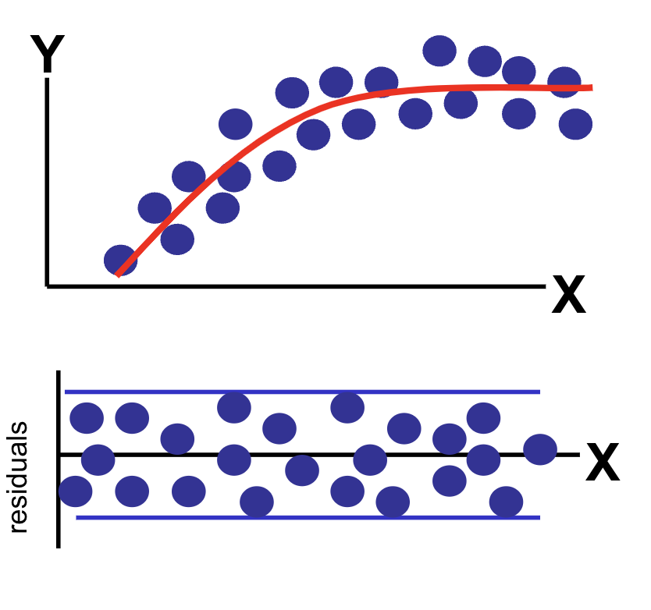
Residual Analysis
1) Plot residuals vs fitted values
2) Plot residuals against independent variables
3) Plot residuals against time (for time-series data)
Look for patterns which may suggest:
Missing variables
Misspecification
Heteroskedasticity
Autocorrelation
Seasonality

Slide 64
Diagnostic Tests
There are several statistical tests used to test the assumptions in regression analysis.
Test | Purpose
F-Test | Overall Model Significance
T-Test | Individual Coefficient Significance
White and Breusch-Pagan | Heteroskedasticity
Durbin-Watson | Autocorrelation
Ramsey's RESET | Functional Form / Variable Selection
Variance Inflation Factor (VIF) | Multicollinearity
Shapiro-Wilk | Normality of Residual
Cook's Distance | Influence / Outliers

Slide 65
Outliers
Outliers do not violate any regression assumptions, but are still important to consider and potentially address

Slide 66
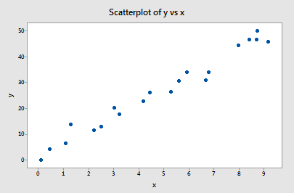
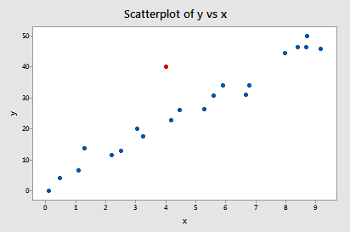
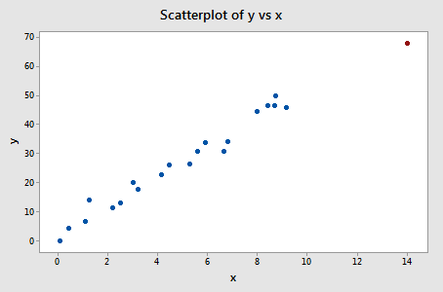
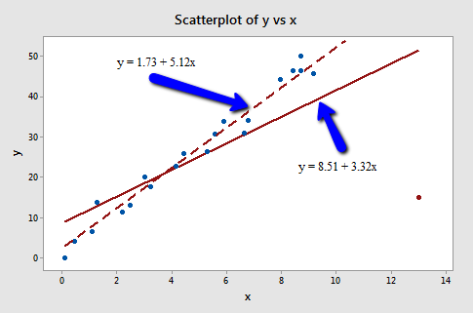
Outliers: Data that does not follow the regression trend
- Weird Y (Large residual)
Leverage: Data with an extreme X value - Weird X (Far from the average predictor values)
Influence: A point that changes the regression line significantly
- Often: Outlier + High Leverage
High-influence observations may be a problem - They can distort the model, so they should be investigated (not blindly deleted)

Slide 67
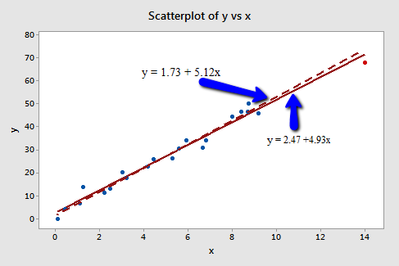

Slide 68
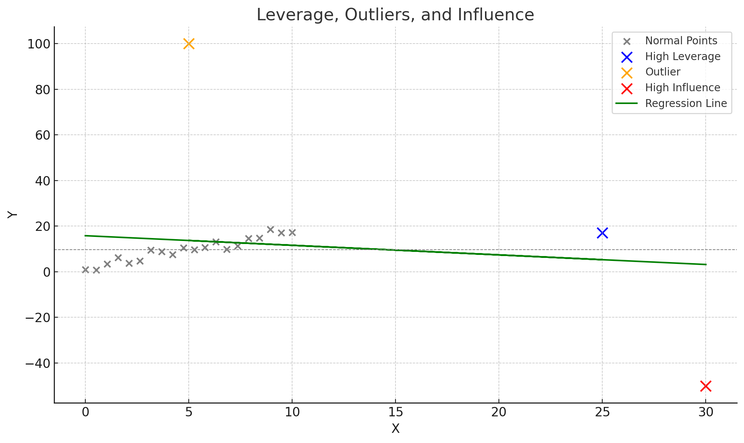

Slide 69
Outlier Detection
Standardized Residuals: Residuals / Standard Deviation of Residuals
Rule of Thumb: If standardized residual > 3 or < -3, it is an outlier
Studentized Residuals: Complicated formula, get the computer to do it for you
Rule of Thumb: If studentized residual > 3 or < -3, it is an outlier
Cook’s Distance: Measures impact on coefficients for each observation
Rule of Thumb: If Cook’s D > 4/(n-k), it is an outlier
Leverage Values: Complicated formula, get the computer to do it for you
Rule of thumb: Points with leverage greater than (2×k)/n have high leverage and are potential outliers

Slide 70
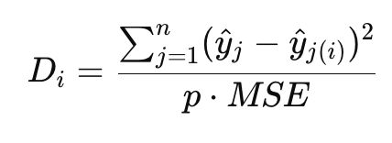
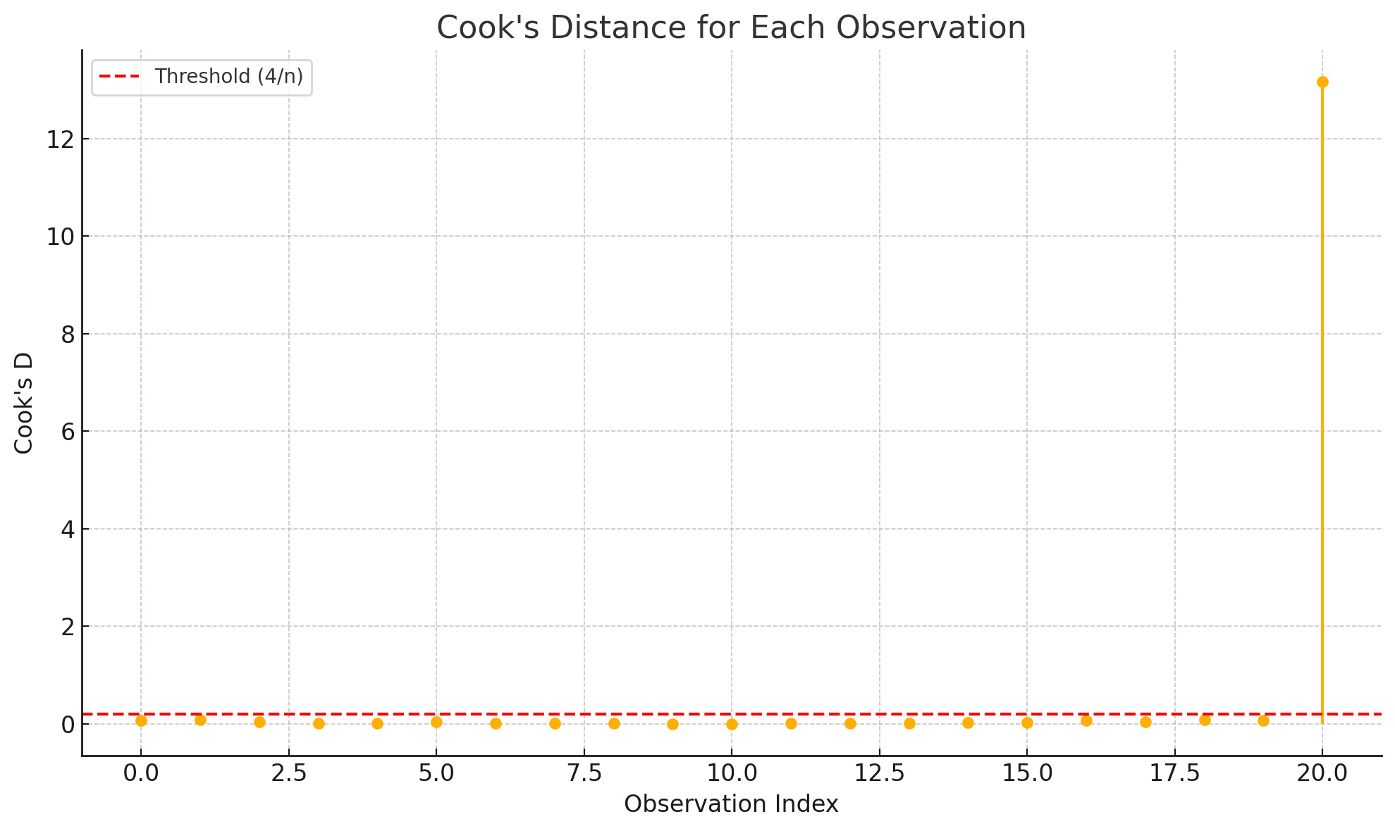
Cook’s D(istance)
Measures how much all fitted values change when a single observation is removed
Observations with D > 1 are suspicious
Observations with D > 4/n are potentially influential
Notes:
P is number of parameters including intercept

Slide 71
Outliers
Detection:
Residual Plot
Standardized and Studentized Residuals
> 3 or < -3 might be outliers
Cook’s D
Observations with Cook’s D > 4/n might be influential outliers
DFBeta:
Shows impact of removing single value on regression equation
Consequences:
Estimates are pulled in the direction of the outlier, possibly distorting the real signal being measured
Solution:
1) Drop outliers
2) Don’t drop outliers
3) Robust regression
4) Report results with and without

Slide 72
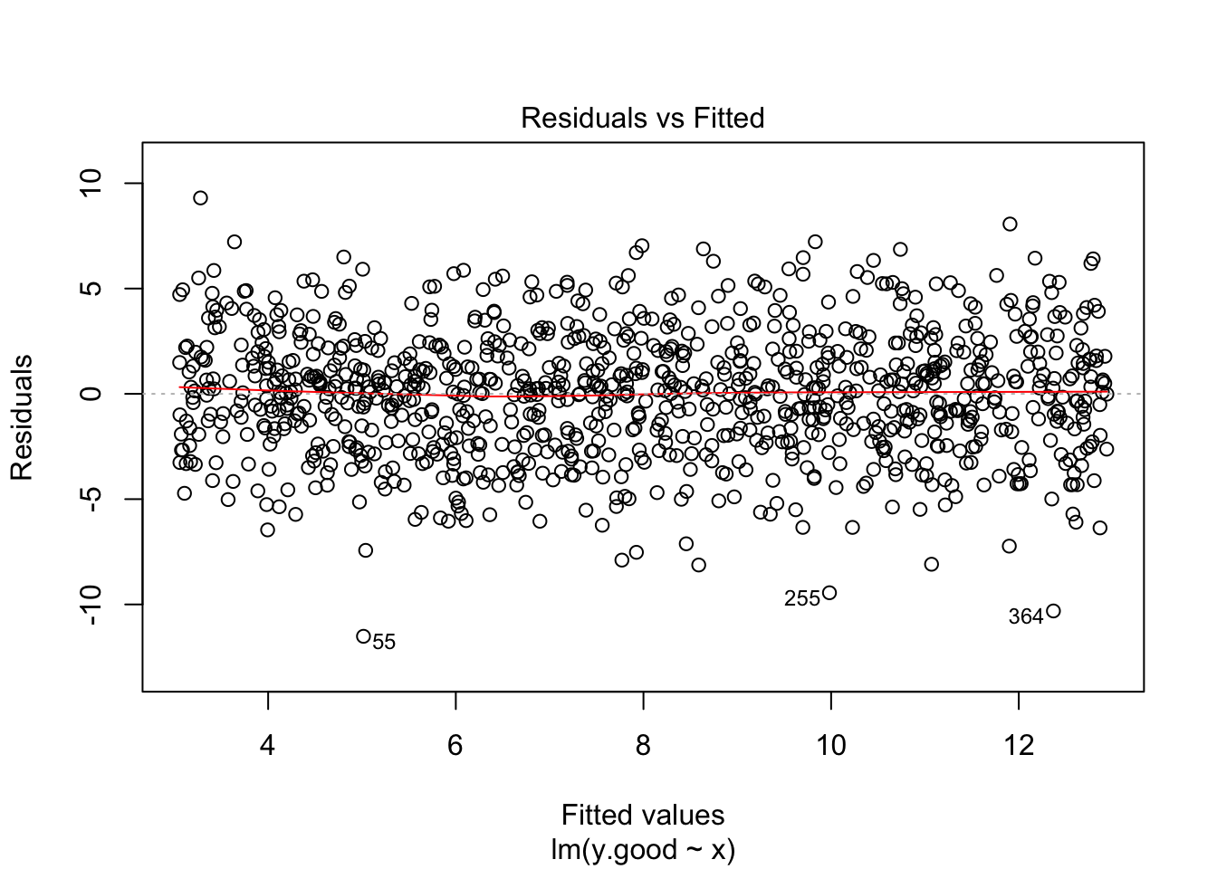
Assumption 10
Residuals are normally distributed (and centered on zero)

Slide 73
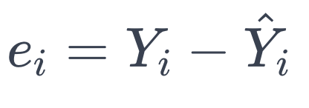
Errors / Residuals
In a correctly specified model:
1) Residuals should appear random
2) Residuals should be centered on zero - If they weren’t, the model would be systematically over / under
3) Residuals should be normally distributed
Normally distributed residuals is not strictly needed for inference unless sample is small
Notes:
FIX THIS

Slide 74
Gauss-Markov
If assumptions are met:
1) Linearity
2) Random sampling
3) No perfect multicollinearity
4) Zero conditional mean
5) Homoscedasticity
OLS is BLUE
Best Linear Unbiased Estimator
Best: Minimum variance
Var(B_OLS) < Var(B_Any other linear unbiased estimator)
Unbiased: On average, the estimate is correct
E[B-hat] = B
Among all ways to estimate the relationship, OLS is the least “noisy”

